Slide 1

Graduate School Strategic Update
Fall 2024
Loyalty Service Culture

Slide 2

A Strategic Business Unit
Enhances the reputation of the college
Supports college operations
Generates essential revenue
Loyalty Service Culture

Slide 3
The Graduate School Mission
MISSON
To empower professionals to achieve their career goals. We deliver flexible, experiential, transformational education that prepares influential leaders with the skills to address the challenges facing today’s global organizations.
BRAND PILLARS
World-class faculty and programs focused on inspiring students to become more confident, self-aware, and resilient.​
Synchronous time and location-independent online programs allow students to adapt educational goals to unique life circumstances.​
Real-world experiential learning opportunities allow students to apply concepts to the workplace to ensure career readiness.​
Personalized career support and an extensive alumni network provide students with exceptional opportunities for career advancement. ​
Loyalty Service Culture

Slide 4
Enrollment Trends
Loyalty Service Culture

Slide 5
Enrollment Goals
Grow traditional graduate enrollment 1% over the next 5 years.
Maintain +1 enrollment to 25% of the Junior class
Loyalty Service Culture
Notes:
Conservative projections in a graduate market that is expected to grow about 1% over the next

Slide 6
How we plan to get there
Enhanced +1 Recruiting Strategy
New Master’s of Mental Health Counseling Program
High-touch In-person Recruiting
Targeted Digital Marketing Campaigns
Corporate Partnership Program
Loyalty Service Culture

Slide 7







Our Partners
Loyalty Service Culture

Slide 8
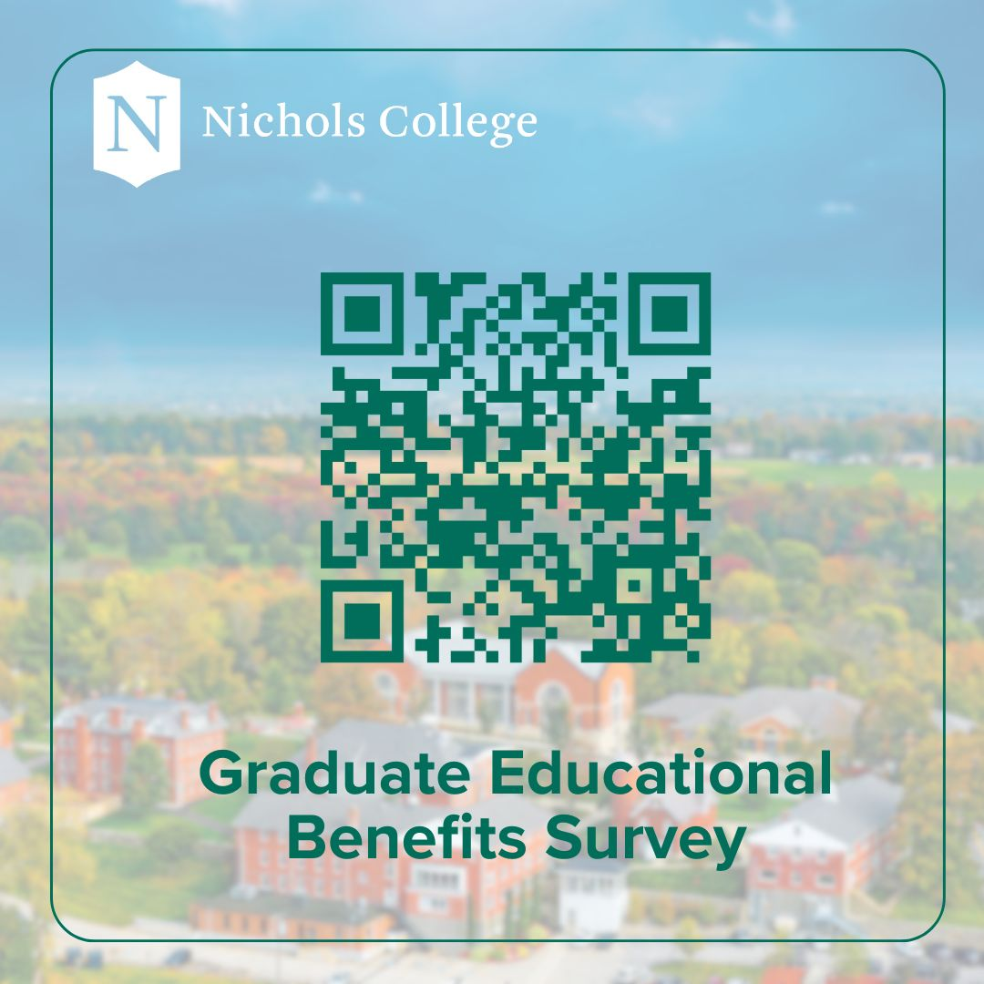
We want your feedback
Loyalty Service Culture

