Slide 1
Title IX Training 2025-2026
Nichols College Title IX & Sexual Misconduct Policies
Brigid Harrington, Senior Attorney

Slide 2

Presenter Contacts
Brigid Harrington, Senior Attorney
Boston
+1 (617) 648-2754
bharrington@hunton.com

Slide 3
Agenda
Prohibited Conduct
  Title IX Policy & Sexual Misconduct Policy
Procedures for adjudicating Complaints
Conducting Investigations and Hearings
  Gathering information
  Drafting reports
  Avoiding bias

Slide 4

The Policies

Slide 5
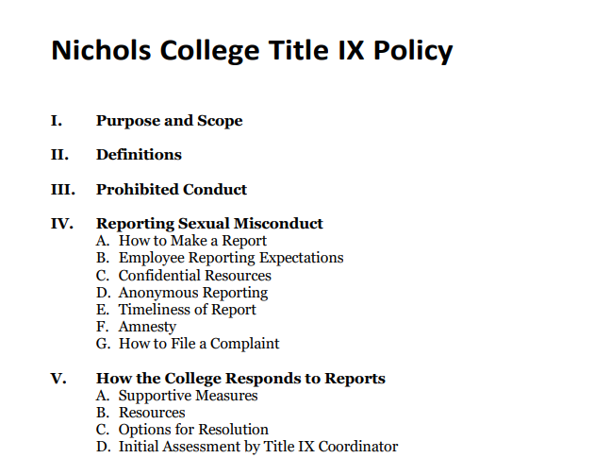
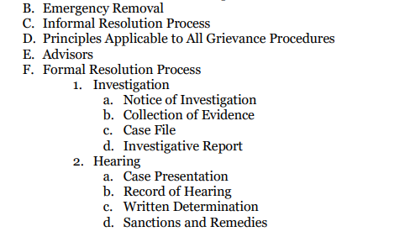
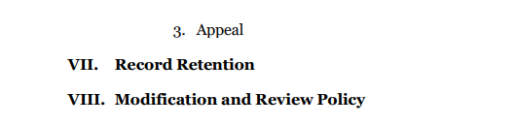
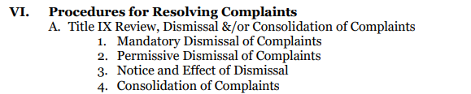
The Policies

Slide 6
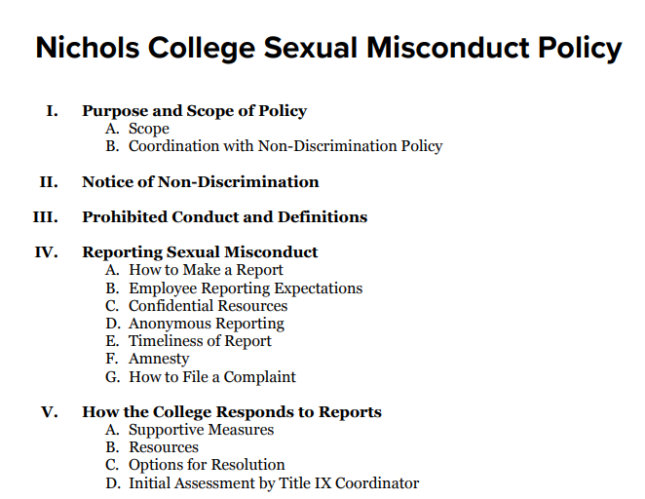
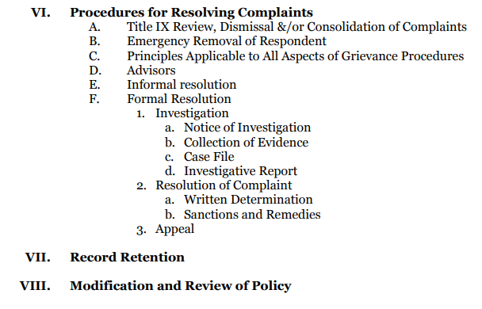
The Policies

Slide 7
The Policies
Title IX Policy
Applies only to conduct on-campus, or in a Nichols program or activity
Applies only in the U.S.
Sexual Misconduct Policy
Applies to any sex-based conduct, anywhere, that impacts participation in a Nichols program or activity
Includes academics, employment

Slide 8
Title IX Policy Violations

Slide 9
Title IX Policy Violations
Must occur within the U.S.
Must occur in a University program or activity
Including on University property
Complainant must be participating or attempting to participate in a College program or activity

Slide 10
Title IX Policy Violations
Sexual Harassment: conduct on the basis of sex that satisfies one or more of the following:
An employee of the College conditioning the provision of an aid, benefit, or service of the College on an individual’s participation in unwelcome sexual conduct
Unwelcome sexual conduct determined by a reasonable person to be so severe, pervasive, and objectively offensive that it effectively denies an individual equal access to the College’s education program or activity
Sexual Assault, Dating Violence, Domestic Violence, or Stalking

Slide 11
Title IX Policy Violations
Sexual Assault: Any sexual act directed against another person, without the consent of the victim, including instances where the victim is incapable of giving consent. . . Includes:
Rape – Penetration, no matter how slight, of the vagina or anus with any body part or object, or oral penetration by a sex organ or sex-related object
Criminal Sexual Contact – Intentional touching of clothed or unclothed body parts without consent for the purpose of sexual degradation, sexual gratification, or sexual humiliation; or the forced touching by the victim of the actor’s clothed or unclothed body parts, without consent of the victim for the purpose of sexual degradation, sexual gratification, or sexual humiliation.

Slide 12
Title IX Policy Violations
Domestic Violence: A crime of violence committed by:
Current or former spouse or intimate partner
Child in common
Current or former cohabitation as a spouse or intimate partner
Protected from each other by DV, family violence laws
Dating Violence: Violence committed by an individual who is or has been in a social relationship of a romantic or intimate nature with the victim
Consider length of relationship, type of relationship, frequency of interaction

Slide 13
Title IX Policy Violations
Stalking: Engaging in a course of conduct directed at a specific individual that would cause a reasonable person to:
Fear for the individual’s safety or safety of others
Suffer substantial emotional distress
Course of conduct = 2 or more acts
Reasonable person = similar circumstances, identities as victim
Substantial emotional distress = may require medical or other professional treatment

Slide 14
Title IX Policy Violations
Retaliation: No individual may intimidate, threaten, coerce, or discriminate against any individual for the purpose of interfering with any right or privilege secured by this policy or because the individual has made a report or formal complaint, testified, assisted, or participated or refused to participate in any manner in an investigation, proceeding, or hearing under this policy

Slide 15
Sexual Misconduct Policy Violations
Complainant may be anyone
Conduct may occur anywhere, but must impact University programs or activities
Overlap with: Title IX Policy
May be consolidated such that Title IX process applies
Overlap with: Non-Discrimination Policy
College will coordinate

Slide 16
Sexual Misconduct Policy Violations
Same/similar to Title IX Policy (just expanded jurisdiction)
Sexual Harassment
Sexual Assault
Stalking
Retaliation
- Severe OR pervasive

Slide 17
Sexual Misconduct Policy Violations
Sexual Exploitation: Act or acts committed through non-consensual abuse or exploitation of another person’s sexuality for the purpose of sexual gratification, financial gain, personal benefit or advantage or any other non-legitimate purpose
Examples:
Observing another’s nudity or sexual activity without their knowledge, or allowing another to observe sexual activity without the consent of all involved
Non-consensual streaming or distribution of sexual activity or nudity without the consent of all involved
Photographing or taping someone in a state of undress or engaging in sexual activity without their consent, or distributing such photographs, video, or audio
Voyeurism
Inducing incapacitation – providing someone with alcohol or drugs, with or without that person’s knowledge, for the purpose of making another person vulnerable to non-consensual sexual activity

Slide 18
Common Definitions
Consent: Voluntary, informed, uncoerced agreement through words or actions freely given, which could be reasonably interpreted as willingness to participate in mutually agreed-upon sexual acts
Consent cannot exist:
With physical force or a reasonable belief of the threat of physical force
With duress
When one individual overcomes the physical limitations of another individual
When an individual is incapable of making an intention decision to participate in a sexual act
Consent is act-specific, can be withdrawn
Silence/lack of resistance does not equal consent

Slide 19
Common Definitions
Incapacitation: A state in which an individual’s perception or judgment is so impaired that the individual lacks the cognitive capacity to make or act on conscious decisions. . . . Engaging in sexual activity with an individual who is incapacitated (and therefore unable to consent), where an individual knows or ought reasonably to have understood that the individual in capacitated, constitutes a violation. . .

Slide 20
Hypothetical
You are assigned to investigate whether Logan, an undergraduate student, sexually assaulted his fellow student, MaryAnne. You gather the following evidence:
Logan and MaryAnne were both present at a party where David Michael saw Logan put a substance into a communal punch bowl. Mallory, who was also at the party, says that she saw MaryAnne, who was drinking a beer, call an Uber for her and Logan around midnight.
Logan’s roommate, Jonathan, tells you that, shortly after midnight, he was lying in bed and heard Logan speaking with another person in their shared on-campus apartment. Jonathan fell asleep, but woke at some point during the night and heard vomiting in their shared bathroom.
Stacy also attended the party, but in her witness interview says that she does not remember anything from that night, and shares that she woke up naked in bed with another student, Charlie, the next morning.
What are your next steps?

Slide 21
Nichol’s Adjudication Processes

Slide 22
Nichols’ Adjudication Process
Reports and Complaints
A Report tells the Title IX Coordinator that Prohibited Conduct may have occurred
All non-confidential employees are mandatory reporters
Reports may be filed anonymously
Does not fill mandatory reporter obligation
A Complaint is a request for the Title IX Coordinator to resolve Prohibited Conduct
Complaints must be in writing
Complaints cannot be anonymous

Slide 23
Supportive Measures
Can be provided regardless of whether Complaint is filed
Must be offered to both parties if a Complaint is filed
Non-disciplinary, non-punitive
No charge
Reasonable
Private (NOT confidential)

Slide 24
Emergency Removal
Available for students if an individualized safety and risk analysis has determined an immediate threat to the physical health or safety of any individual
Student may meet with TIXC to contest removal
May have advisor present

Slide 25
Initial Assessment of Reports or Complaints
Title IX Coordinator determines how to proceed
TIXC-initiated complaint
Investigation
Dismissal
Other remedial action
Referral

Slide 26
Dismissal
Mandatory:
If conduct would not violate Title IX Policy
Can refer to another policy
Optional:
If Complainant withdraws in writing
If Respondent is no longer enrolled or employed by College
If specific circumstances prevent the College from gathering sufficient evidence to reach a determination
Dismissal is subject to appeal

Slide 27
Grievance Processes
Prompt & equitable
Equal rights to participate
Right to an advisor of choice
Administrators participating must be free of bias or conflict of interest
Presumption of good faith reporting
Presumption of non-responsibility
Expectation of cooperation from community members

Slide 28
Informal Resolution Process
Available only after Complaint has been filed
Facilitated by trained individual
Title IX Coordinator must approve pursuit of informal resolution & agreed resolution
Not available in matters involving a student vs. an employee
Voluntary
Parties can withdraw
Typically 30 days to complete

Slide 29
Title IX Process vs. Sexual Misconduct Process
Title IX Process:
Notice
Collection of Evidence
Sharing and Response to Case File
Investigative Report
Hearing
Hearing Officer Determines Responsibility, Sanctions, and Remedies
Appeal
Sexual Misconduct Process:
Notice
Collection of Evidence
Sharing and Response to Case File
Investigative Report
Title IX Coordinator Determines Responsibility, Sanctions, and Remedies
Appeal

Slide 30
Notice
Provided to both parties
Sets the scope of the investigation
Allegations: who, what, where, when (if known)
Applicable policy sections
Additional allegations/charges → additional notice

Slide 31
Investigation
Goal: Gather relevant, permissible evidence
Interview witnesses, gather documents, video, etc.

Slide 32
Relevance
Evidence is relevant if it tends to show that conduct occurred as alleged, or tends to show that conduct did not occur as alleged
Character evidence is not generally relevant
Evidence about the credibility of a witness or party’s account is relevant

Slide 33
Relevance
Evidence that is not permissible (even if relevant):
Evidence about a Complainant’s prior sexual behavior or disposition
Unless offered to prove consent, or that someone other than Respondent committed alleged conduct
Medical/counseling or other privileged records obtained without written consent

Slide 34
Gathering Evidence
Do:
Listen first, circle back for details later
Details are crucial, may take more than one interview
Ask for definitions of words
Allow for time to answer
Allow for breaks, acknowledge emotions
Ask for phone/documentary evidence → get it in the interview!
Ask: Who else should I talk to?
Ask: What am I missing?
Don’t:
Ask leading questions
Imply judgment (may have to explicitly state that you are not judging)
Explicitly identify with parties or witnesses
Make assumptions based on identification with a party or witness
Make assumptions based on characteristics of a party or witness

Slide 35
The Case File
All “directly related” evidence
Including evidence that may not appear in investigative report
Witness interviews, documents, videos
FERPA redacted
Provide to parties and allow them to respond
What if response includes additional relevant witnesses or information?

Slide 36
Title IX Hearing
Hearing Officer will review investigation report and evidence
May request to hear from witnesses who were interviewed by investigator
Parties may request witnesses
All questions from parties to other party and witnesses will be posed by their advisor

Slide 37
Role of Title IX Hearing Officer
Relevance determinations
Independent assessment of evidence and credibility
Determination of responsibility based on preponderance of the evidence standard

Slide 38
Investigative/Hearing Reports: Synthesizing Evidence
Compare accounts, documents, timestamps
What makes sense?
You may never see the full picture [Insert graphic of a puzzle with a piece missing]
Pieces may not fit together

Slide 39

Investigative/Hearing Reports: Synthesizing Evidence
Compare accounts, documents, timestamps
What makes sense?
You may never see the full picture
Pieces may not fit together

Slide 40
Assessing Credibility
Credibility of an account is not equal to credibility of a person
Credibility can be impacted by:
Opportunity to observe
Intoxication
Memory
Some aspects of an account may be credible, while others may not be

Slide 41
Assessing Credibility
Credibility is not equal to demeanor!

Slide 42
Nichols Population
1,164 undergraduate, 239 graduate students
  1054 of undergraduates are full-time
64.8% male, 35.2% female, 0% other
70% identify as white; 26% as racial/ethnic minorities
30% awarded Pell Grants
40% from out of state
International students from 18 countries
Sources: U.S. News & World Report; collegefactual.com

Slide 43
Avoiding Bias
Actual bias vs. the appearance of bias
  Goal: Avoid both
Implicit bias: a negative attitude, of which one is not consciously aware, against a specific social group
  Thought to be shaped by experience and based on learned associations
  Social categories may include race, gender, disability
Mitigating strategies:
- Create new associations
- Minimize bias in decision making
Source: American Psychological Association; Project Implicit

Slide 44
Implicit Bias
Project Implicit-based Research:
Implicit and Explicit Attitudes Toward African Americans and Barack Obama Did Not Substantively Change During Obama’s Presidency
Health Care Providers Favor Heterosexual People over Lesbian and Gay People
Implicit Black-weapon Associations Weakened Over Time in Increasingly Multiethnic Metropolitan Areas
Attitudes Toward People with Intellectual Disability Associated with Integrated Sports Participation
Source: Project Implicit

Slide 45
Avoiding Implicit Bias in Investigations and Hearings
Creating and recognizing associations
  Know your campus
  Do not make assumptions about the parties/witnesses → instead ask them about their though process, decision
Minimize bias in decision-making
  Articulate the basis of your finding
  Scrutinize your conclusions for implicit bias
  Share your reasoning with others

Slide 46
The Effects of Trauma
Trauma MAY impact:
  Ability to remember
  Feelings of blame/shame
  Brain function → reactions to traumatic event
During a traumatic event, victims may experience
  Self-protective habits
  Dissociation
  Immobility
Response to trauma may be shaped by childhood/other prior experiences
  You may not know about/be able to predict responses
REGARDLESS of trauma, memory may be unreliable
  The brain does not operate like a video camera
  Memories impacted by state of mind, perspective

Slide 47
Trauma-Informed Investigations
Avoid the appearance of judgment
Be curious – ask questions to understand the situation
Allow space for emotions
Allow support/items to put interviewee at ease
Recognize that you may never see all of the pieces of the puzzle
EVALUATE THE EVIDENCE THAT YOU HAVE, NOT THE EVIDENCE YOU DO NOT HAVE
Indications of trauma are part of the puzzle but, on their own, do not necessarily mean that a Policy violation occurred

Slide 48
Writing Reports – Sample Outline
Executive summary/intro
Procedural Steps
  Every step between filing of complaint and issuing of report
  Notice, witness interviews, case file shared, etc.
Applicable Policy Sections
Summary & assessment of evidence
Conclusion/Determination and Next Steps
  Investigative report – who will you provide report to
  Hearing report – include determination, sanctions (including who will implement), remedial measures, and appeal rights

Slide 49
Writing Reports – Best Practices
Group evidence chronologically, by event
Conclusions about credibility, responsibility, should flow logically from the evidence
You should be able to state why you were/were not able to find an event likely occurred

Slide 50
Writing Reports – Exercise
Using the information that we have discussed about MaryAnne’s complaint, outline your report and include information that you would expect to gather

Slide 51
Writing Reports – Exercise
Summary & assessment of evidence
Background information about the parties
Information about the party
  MaryAnne’s account
  Logan’s account
  Witness accounts
Information about the parties leaving the party
  Uber receipts?
Information about events at Logan’s apartment
  MaryAnne’s account
  Logan’s account
  Witness accounts

