Slide 1

Undergraduate
Fall 2025
New Student Onboarding
Overview
Undergraduate Fall 2025
Admissions + IT

Slide 2
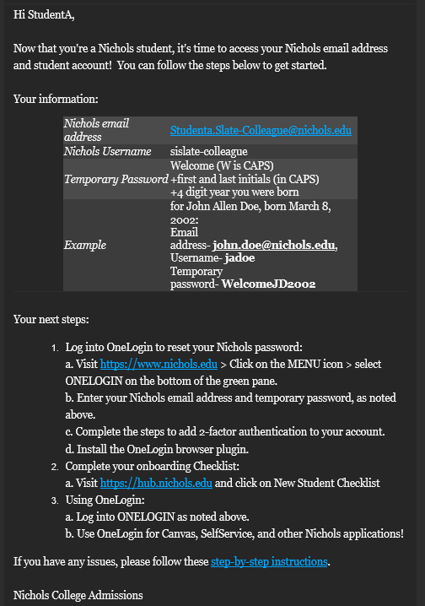
New Student Onboarding: Student Experience
Undergraduate
Fall 2025
Deposit > Enrolled > Access to Nichols
Target Launch Date : Thursday, May 1st
Account Generation : 2 days from deposit
  Nichols Email Address
  OneLogin Account
Automated Welcome Email

Slide 3
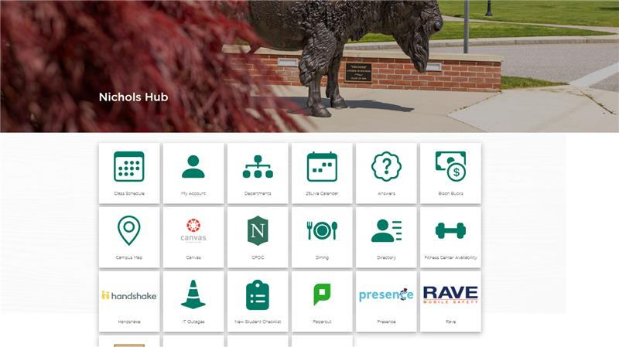
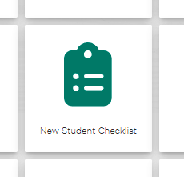
New Student Onboarding: Student Experience
Undergraduate
Fall 2025
hub.nichols.edu

Slide 4
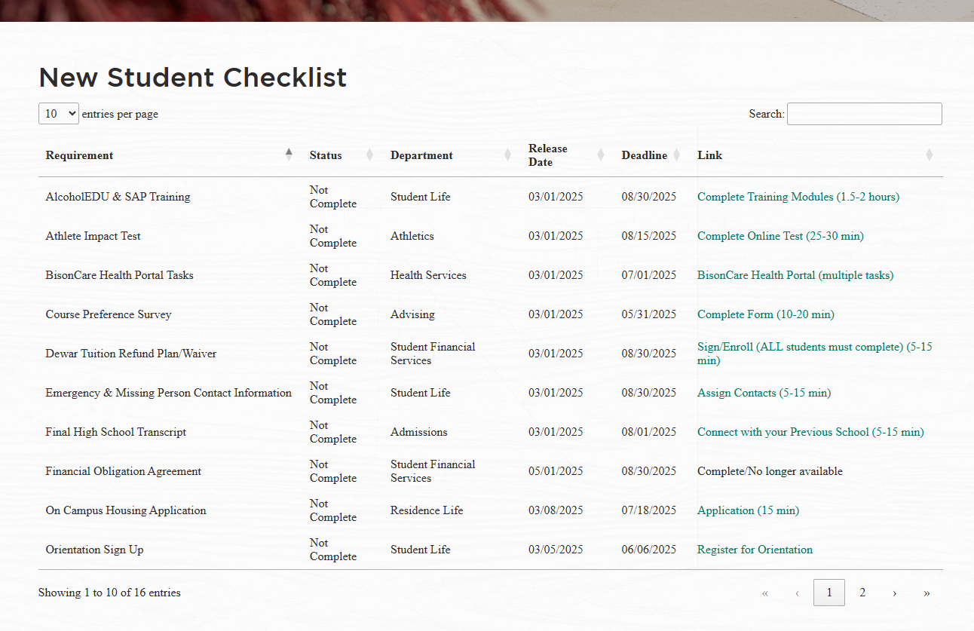
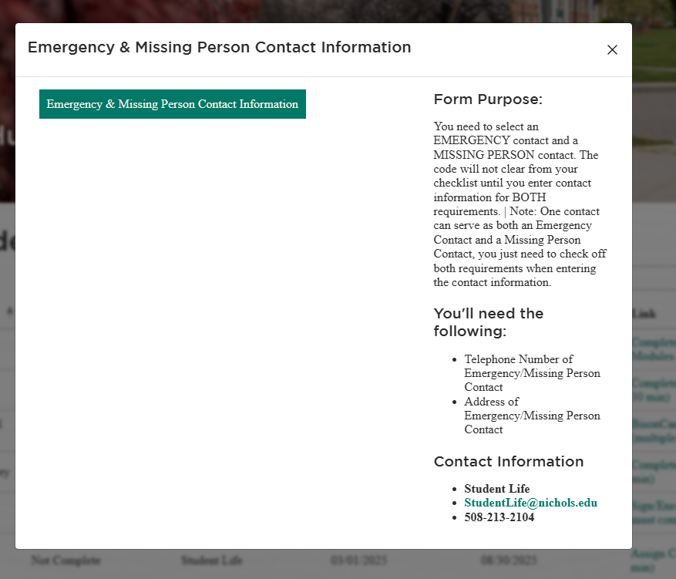
New Student Onboarding: Student Experience
Undergraduate
Fall 2025
hub.nichols.edu

Slide 5
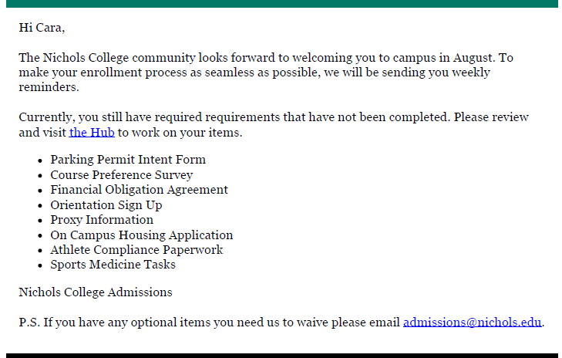
New Student Onboarding: Student Experience
Undergraduate
Fall 2025
hub.nichols.edu
Automated Weekly Reminder

Slide 6
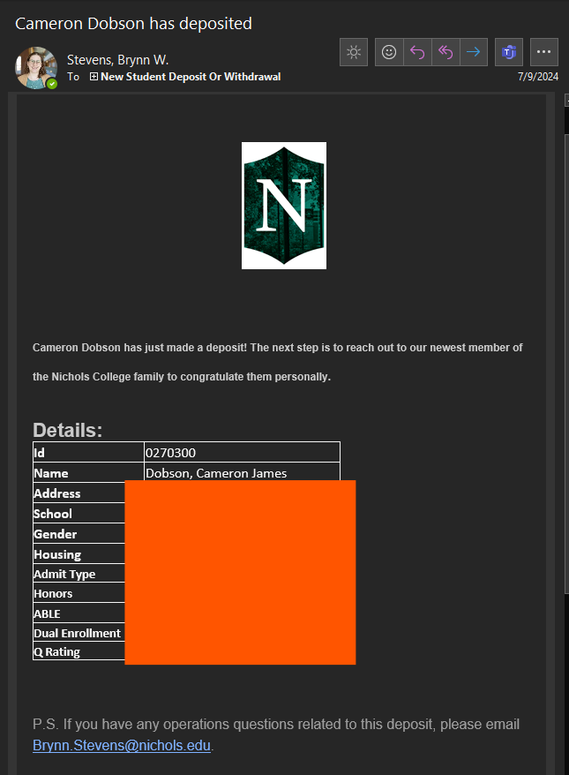
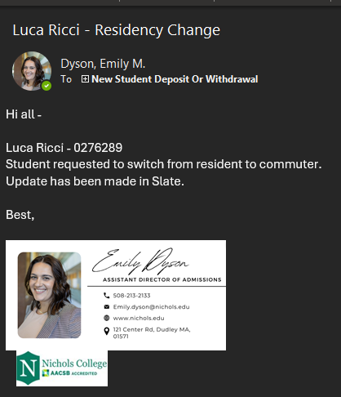
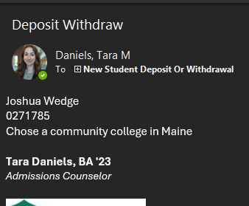
New Student Onboarding: Staff Experience
Undergraduate
Fall 2025
For Departments directly involved with onboarding:
**New Student Deposit or Withdrawal email group**
May 1st : Community query of all available
new student information
After May 1st : Individual changes by email
        New Deposits
        Withdrawals
        Changes in Billing (i.e. Residential Status)
Confirm participation with your department, then submit an IT ticket to be added
Deposit Notifications are Automated

Slide 7
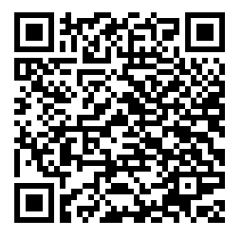
New Student Onboarding: Troubleshooting
Undergraduate
Fall 2025
hub.nichols.edu
IT Articles: Everything you need to know (Incoming Freshmen)
Student Questions
IT Help? → Helpdesk or UG Counselor
Access Checklist? → HUB
Dept. Questions? → HUB

Slide 8
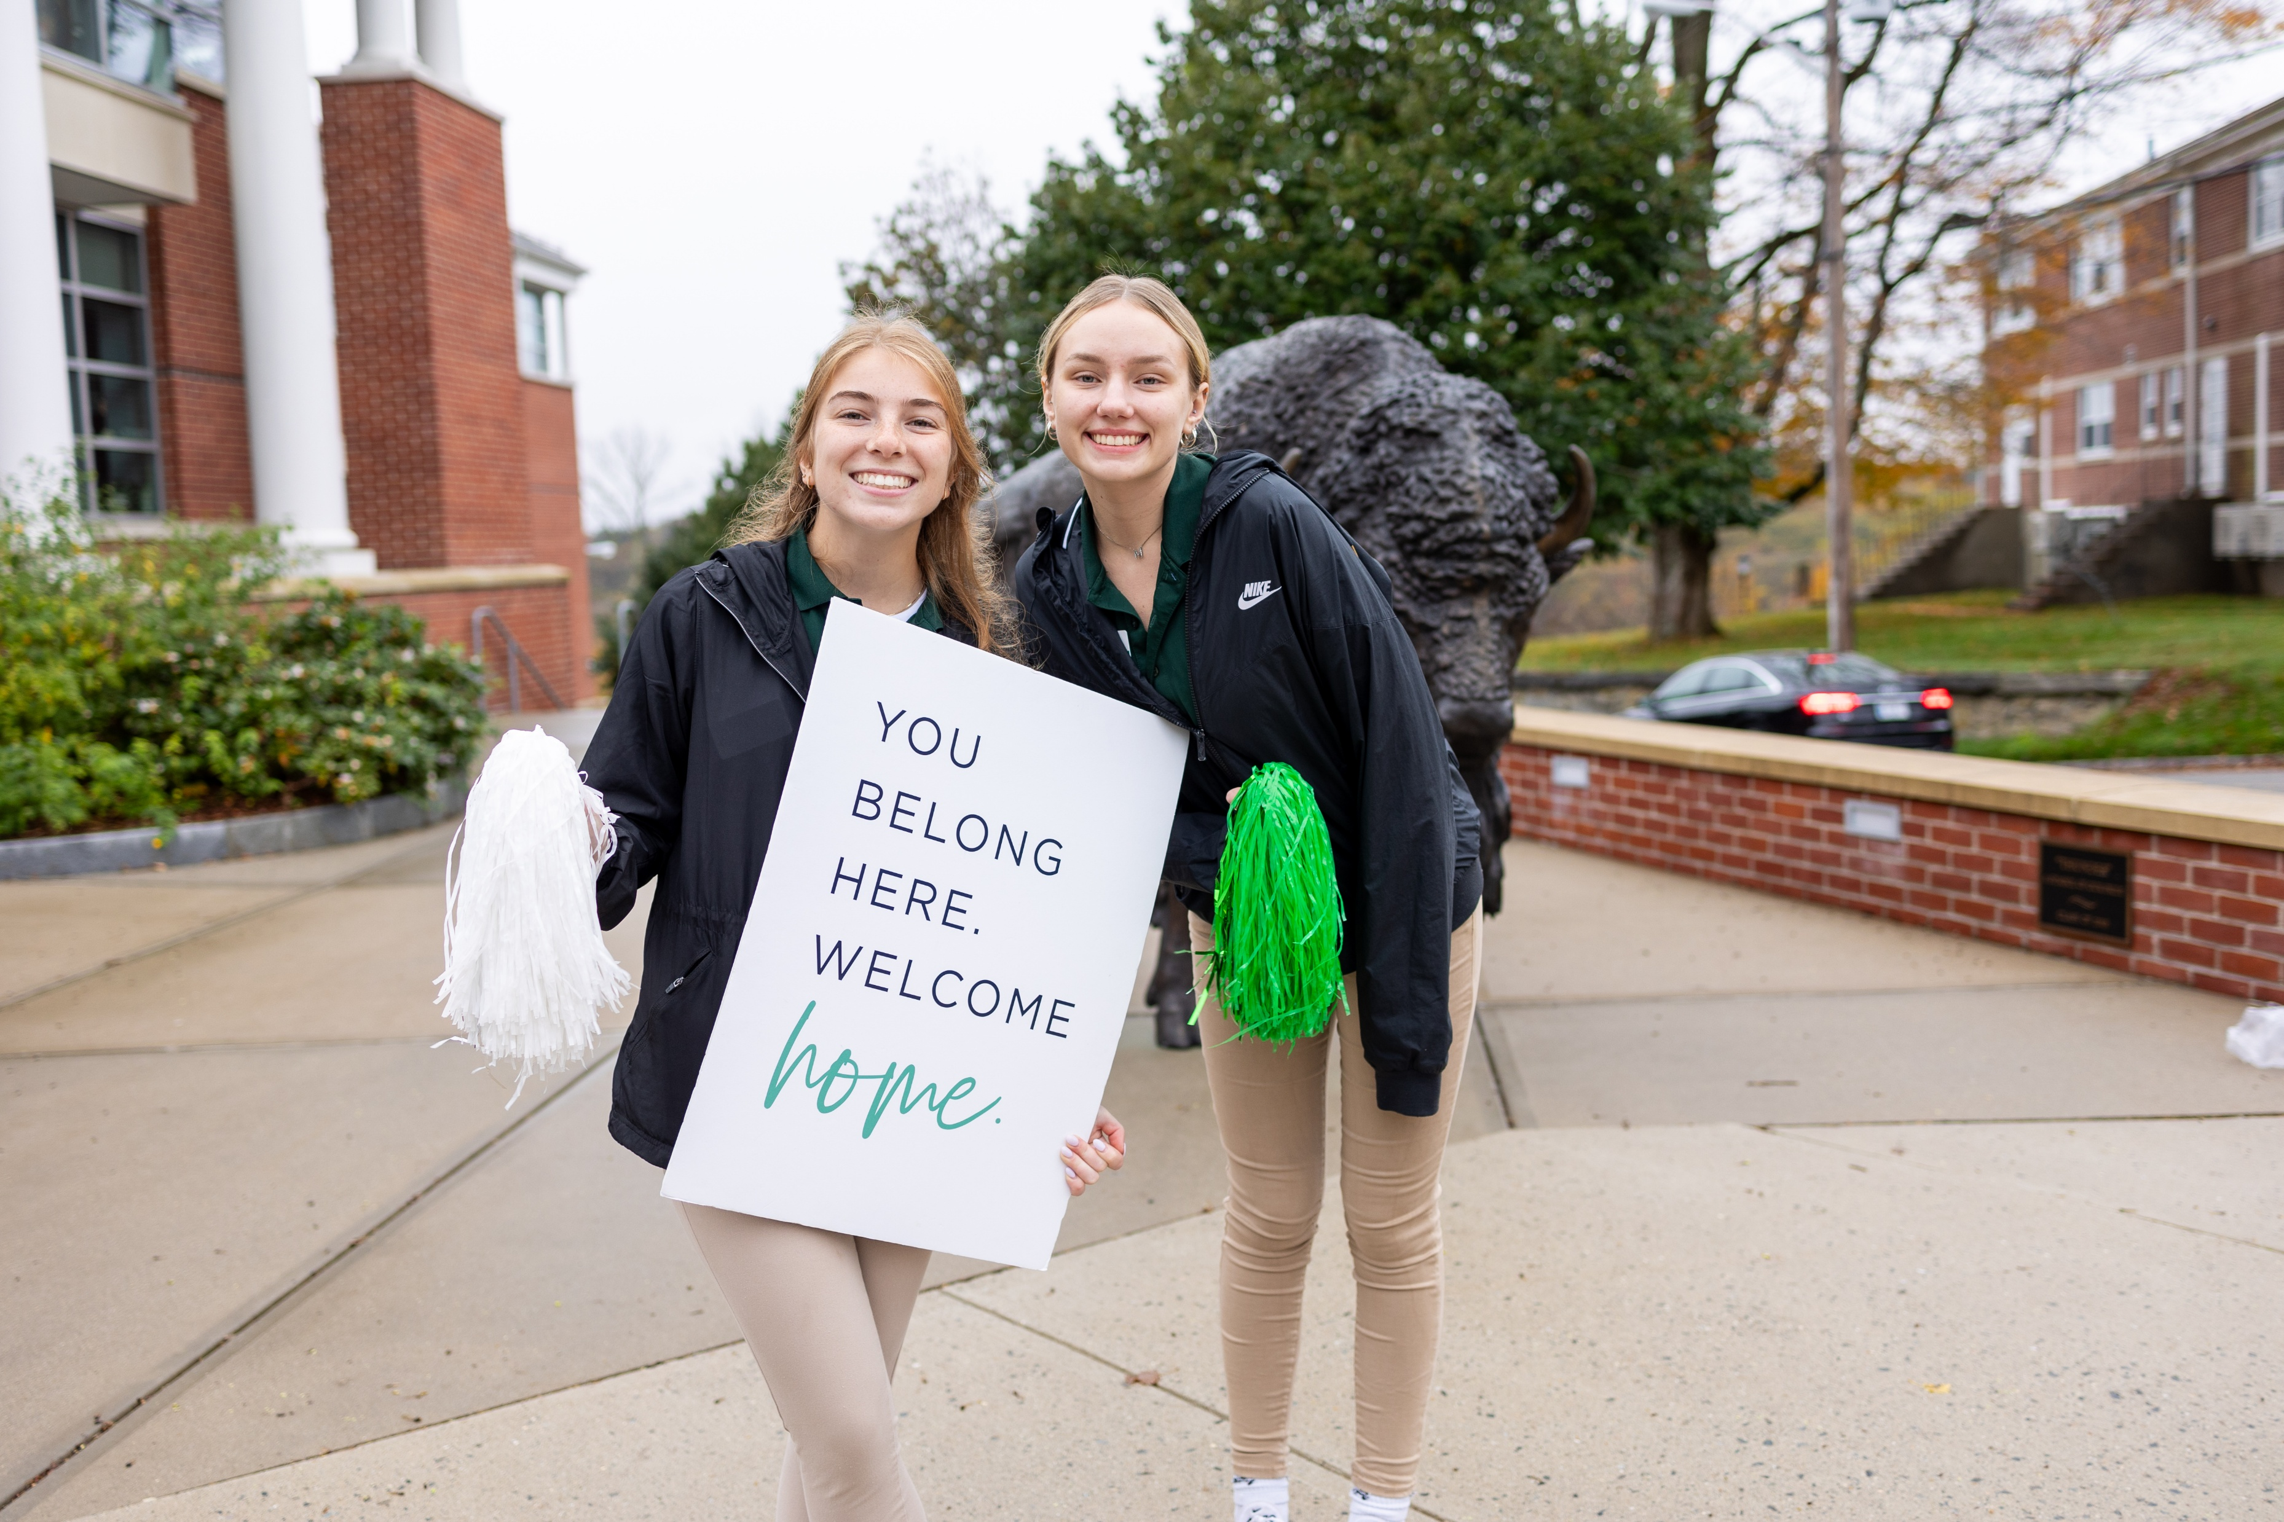
New Student Onboarding
Undergraduate
Fall 2025
Thank you!
Internal Questions?
  Ask your Department Head
  Contact Admissions or IT
  Brynn.stevens@nichols.edu
hub.nichols.edu

